Slide 1
Checkpoint 3
Meghna Behari, Thomas Garity, Anika Lakhani

Slide 2
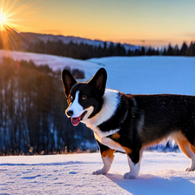
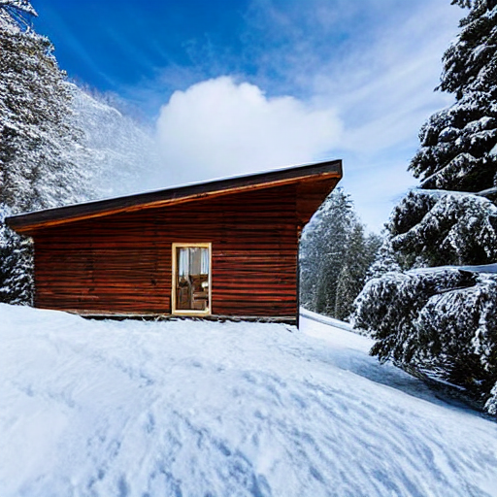
Spurious Correlations

Slide 3
Train on corgi dataset
Train on snow dataset to detect corgis
Mathematically compare the two sets of results to find spurious correlations

Slide 4
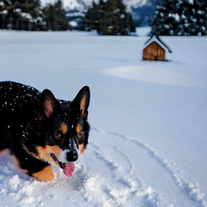
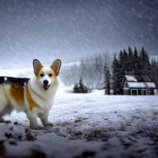
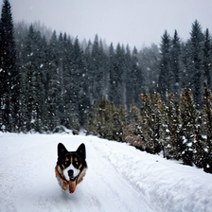
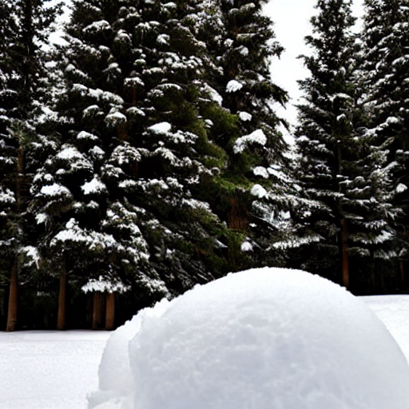
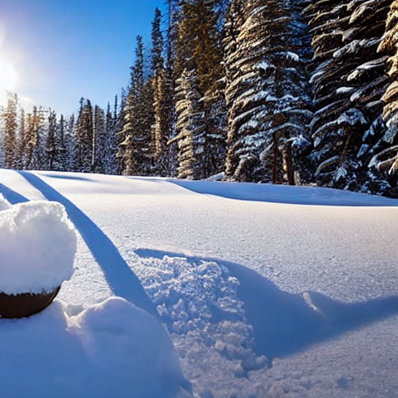
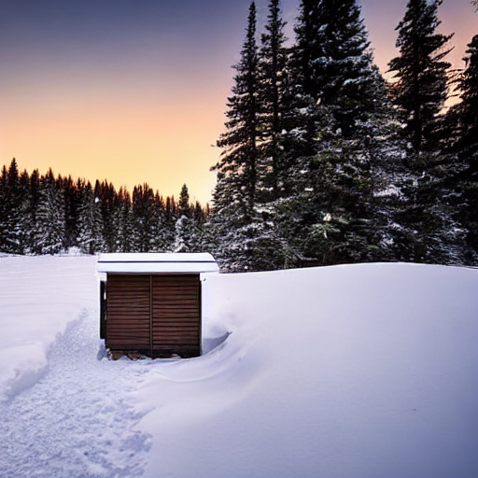
+
Augmented our corgis dataset to include snow-only pictures

Slide 5

Got other concept-based classification methods working

Slide 6
Concepts in Dataset A
Dataset A
Concepts in Database B
Dataset B
Mathematical Way to Generate Spurious Scores

Slide 7
Concepts in Dataset A
Are there spurious concepts in here?
What is the maximal set of concepts that we can remove to preserve classification accuracy of x%?
Concepts in Database B
Mathematical Way to Correct Model

